Slide 1
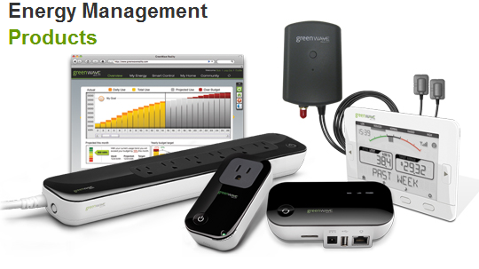
EMS Team Meeting
Johnny Nguyen
Binjue Wu
Camilo Aguilar
Mohsin Farooqui
Andrew Wang
December 7, 2012

Slide 2
Milestones
Able to recognize both individual devices, stored in database, and multiple, same devices (ie if there are two footfans fans, identifies there are two fans).
Used Zigbee board to convert input using the ADC, and compute different load signature characteristics using buffers.

Slide 3
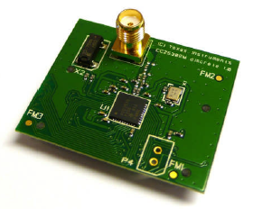
Hardware/Zigbee CC2530
Johnny Nguyen
Camilo Aguilar
Christian Goldau

Slide 4
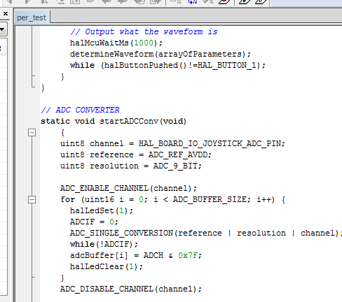
Progress-What we learned
Documentation for board difficult
Invaluable microcontroller experience for Camilo and I
Using different libraries of controller and C
Learned limitations of controller vs computer C code

Slide 5
Progress-Results
ADC-Converter-Input
Distinguish devices at microcontroller level.
Demo

Slide 6
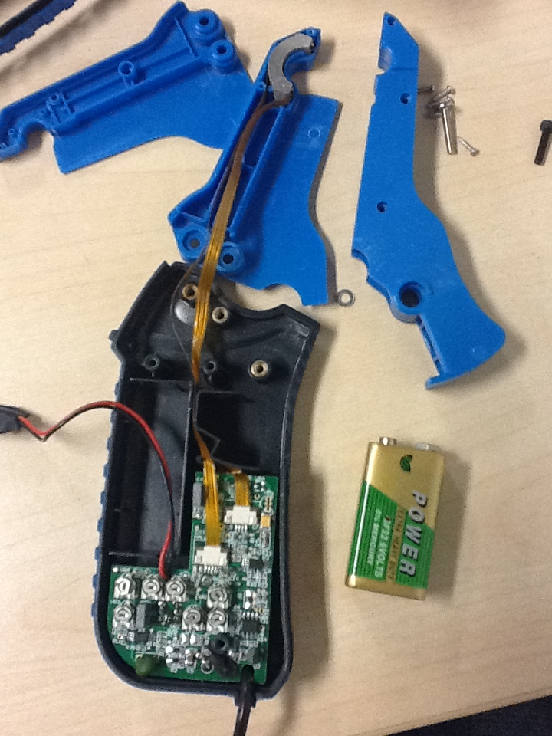
Upcoming tasks
Hardware to replace current probe
Better Resolution in ADC
Prepare design for Charles

